Slide 1
Dialect contact and
the emergence of new varieties
Li 4 History & Varieties of English Lent 2021 Week 7 Deepthi Gopal (dg537@cam.ac.uk)

Slide 2
The story so far
Last week: what is language contact? What kinds of change do we think can be induced in one language by the presence of another?
Thomason & Kaufmann (1988), Thomason (2001): scales of borrowing and of sociolinguistic contact situation, from the ‘easiest’ borrowing (infrequent bits of the lexicon) to the ‘hardest’ (major, ‘deep’ structural change, like word order or large-scale inflectional morphological change); and from situations of least ‘intense’ contact to situations of extremely ‘heavy’ contact.
What does it mean for contact to be intense? Time in contact; extent to which the speakers of languages involved are really bilingual; relative sizes of the groups in contact (asymmetric!); relative prestige of the languages involved (asymmetric!).
This week: dialect contact, or something we can think of as a special case of the general idea of language contact. What happens when speakers of different varieties of English come into contact with one another?

Slide 3
The geographical diffusion of variation
How does a new variant spread from one place to another? We know that a lot of the variation that we’ve seen in this course has been traceable to particular points of origin.
Think about intrusive ‘r’ (Lent Lecture 2) or quotative ‘be like’ (Lent Lecture 4), both of which seem to have clear regions of origin: the western United States for ‘be like’, London and the South-East for intrusive /r/.
— but not everything is so obliging. Recall from Lent Lecture 2 that we’re unsure about the ultimate origin of t-glottalisation in British English; although the earliest attestations of it are Scottish, there are claims about a Norfolk origin (Trudgill 2016), associations with Cockney … how do we know?

Slide 4
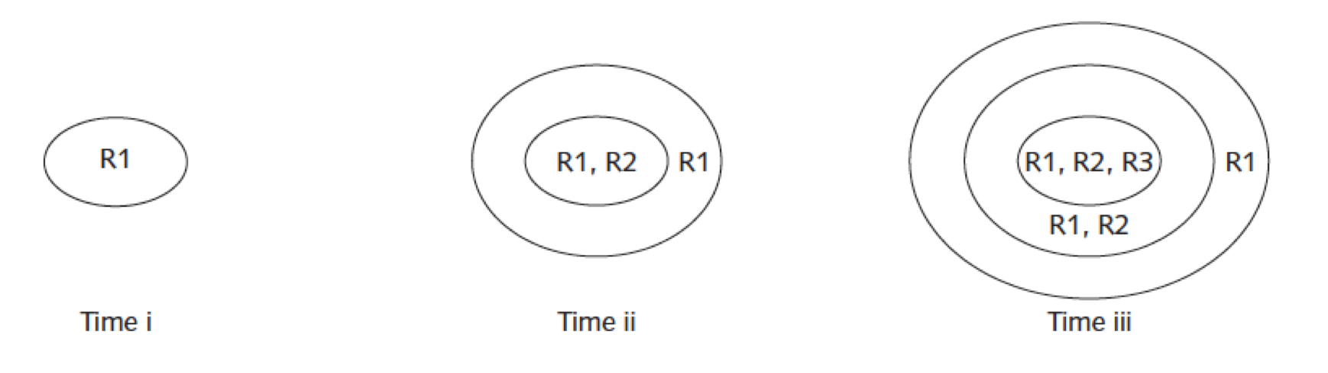
The geographical diffusion of variation
In 1872, Johannes Schmidt proposed the wave model to explain the spread of innovations in Indo-European: one of the problems for historical reconstruction is that features sometimes seem to be able to ‘jump’ across family lines (via contact), and these features tend to be distributed in space following complex patterns.
The basic idea (intuitively) is that we expect new stuff to spread outward from the place in which it was innovated, fairly evenly. Figure from Wolfram & Schilling-Estes 2003:
Lots of subsequent work in sociolinguistics and dialectology takes this underlying conception of the geographical spread of change for granted.

Slide 5
The geographical diffusion of variation
In 1872, Johannes Schmidt proposed the wave model to explain the spread of innovations in Indo-European: one of the problems for historical reconstruction is that features sometimes seem to be able to ‘jump’ across family lines (via contact), and these features tend to be distributed in space following complex patterns.
The basic idea (intuitively) is that we expect new stuff to spread outward from the place in which it was innovated, fairly evenly. Wolfram & Schilling-Estes 2003:
Lots of subsequent work in sociolinguistics and dialectology takes this underlying conception of the geographical spread of change for granted.
Trudgill (1974): but this isn’t enough. We also need to explain the fact that geographical distance isn’t the only predictor of the adoption of variation: some places have disproportionate influence on others (even accounting for distance.
Norwich is heavily influenced by the spread of features from London (150km), and not particularly by Birmingham (200km); but these distances aren’t that different …
Features spread to relatively large but isolated centres like Norwich before they spread to smaller places between Norwich and London: large places seem to be ‘ahead’ of small places.

Slide 6
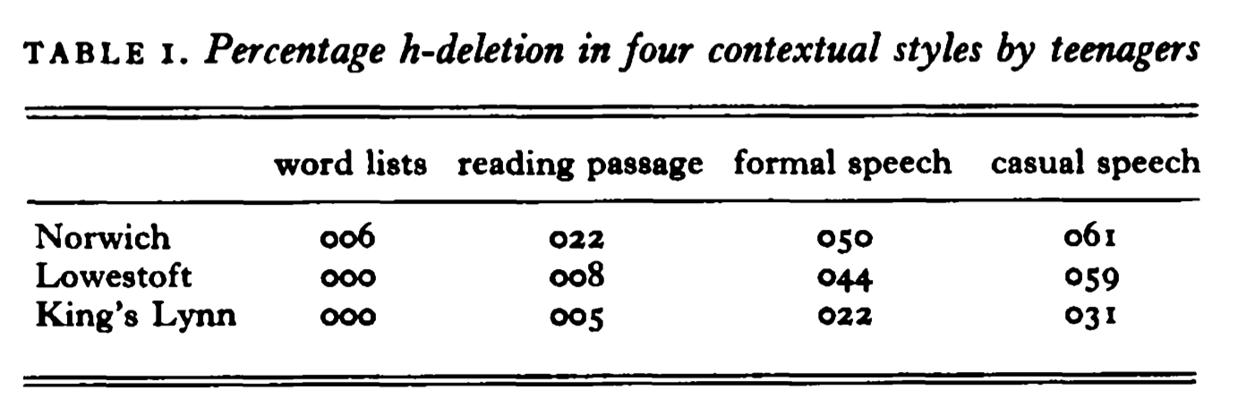
The geographical diffusion of variation
In 1872, Johannes Schmidt proposed the wave model to explain the spread of innovations in Indo-European: one of the problems for historical reconstruction is that features sometimes seem to be able to ‘jump’ across family lines (via contact), and these features tend to be distributed in space following complex patterns.
The basic idea (intuitively) is that we expect new stuff to spread outward from the place in which it was innovated, fairly evenly. Wolfram & Schilling-Estes 2003:
Lots of subsequent work in sociolinguistics and dialectology takes this underlying conception of the geographical spread of change for granted.
Trudgill (1974): hierarchical model, in which change can ‘jump’ from large places to other large places before reaching smaller ones, even if those smaller ones are just as geographically close to the original source of the change.

Slide 7
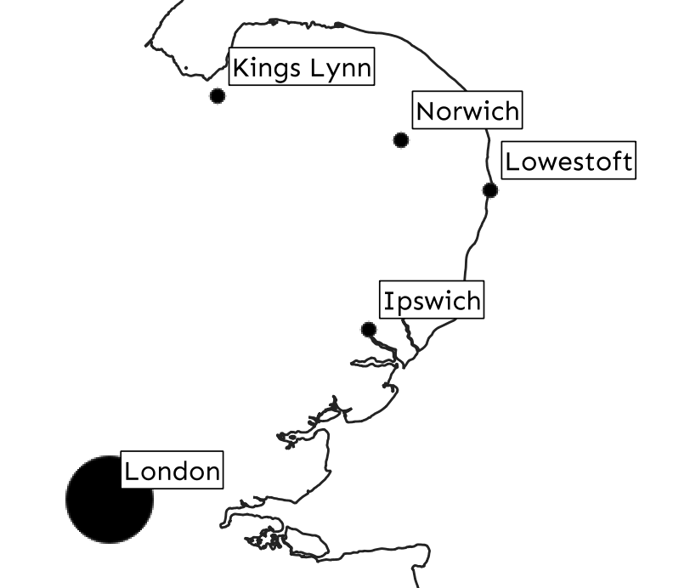
The geographical diffusion of variation
In 1872, Johannes Schmidt proposed the wave model to explain the spread of innovations in Indo-European: one of the problems for historical reconstruction is that features sometimes seem to be able to ‘jump’ across family lines (via contact), and these features tend to be distributed in space following complex patterns.
The basic idea (intuitively) is that we expect new stuff to spread outward from the place in which it was innovated, fairly evenly. Wolfram & Schilling-Estes 2003:
Lots of subsequent work in sociolinguistics and dialectology takes this underlying conception of the geographical spread of change for granted.
Trudgill (1974): hierarchical model, in which change can ‘jump’ from large places to other large places before reaching smaller ones, even if those smaller ones are just as geographically close to the original source of the change.

Slide 8
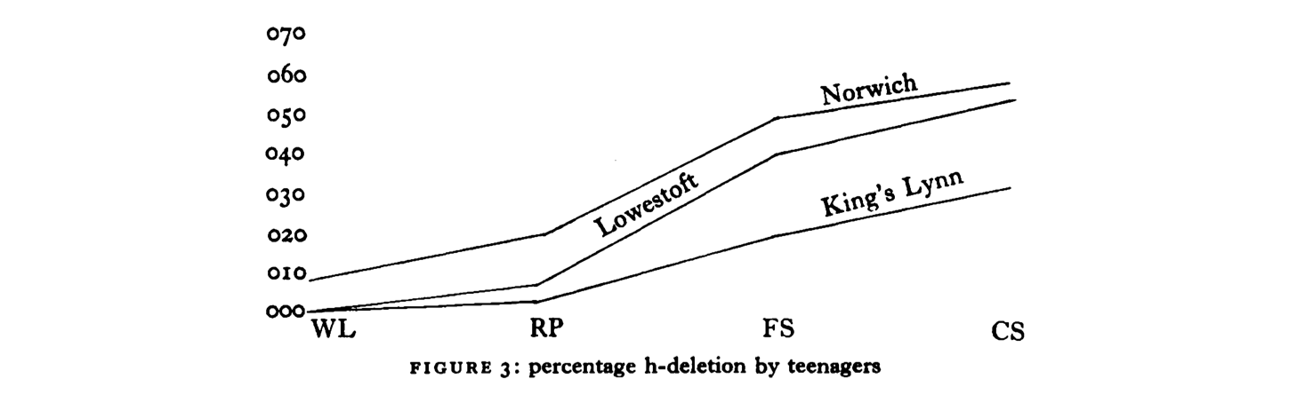
The geographical diffusion of variation
Norwich is ahead of Lowestoft and King’s Lynn on rates of h-dropping, despite all three being pretty similarly distant from London. (Lowestoft is probably ahead of King’s Lynn because of the combined influence of London and Ipswich.)
In 1872, Johannes Schmidt proposed the wave model to explain the spread of innovations in Indo-European: one of the problems for historical reconstruction is that features sometimes seem to be able to ‘jump’ across family lines (via contact), and these features tend to be distributed in space following complex patterns.
The basic idea (intuitively) is that we expect new stuff to spread outward from the place in which it was innovated, fairly evenly. Wolfram & Schilling-Estes 2003:
Lots of subsequent work in sociolinguistics and dialectology takes this underlying conception of the geographical spread of change for granted.
Trudgill (1974): hierarchical model, in which change can ‘jump’ from large places to other large places before reaching smaller ones, even if those smaller ones are just as geographically close to the original source of the change.

Slide 9
Dialect levelling
Related to the idea that large places have disproportional influence is the phenomenon of dialect levelling, or the tendency of varieties to lose distinctively local features and converge toward each other, or toward some broader local or global standard.
A major focus of a lot of recent sociolinguistics of English; Cheshire et al. (1989/1993), Kerswill & Williams (2000), Milroy, Milroy & Hartley (1994), Britain (1997) …
This is one kind of contact-induced dialect change: dialects in contact becoming more similar.
Watt (2002) looked at the levelling of the rather distinctive Tyneside (Newcastle) vowel system toward a regional standard.

Slide 10
Dialect levelling
FACE, GOAT are very variable in English generally (as you know!), and perhaps even more so in Tyneside in particular.
The ‘new’ diphthongised variants characteristic of standard Southern British English, [eɪ] [oʊ];
The ‘old’ monophthongs or near-monophthongs, characteristic of the ‘North of England’ and Scotland generally, [eː] [oː];
— and Tyneside has a particular distinctive set of local variants, [ɪə] FACE, [ʊə] GOAT (Holmes 2000, Watt 2000).

Slide 11
Dialect levelling
FACE, GOAT are very variable in English generally (as you know!), and perhaps even more so in Tyneside in particular.
The ‘new’ diphthongised variants characteristic of standard Southern British English, [eɪ] [oʊ];
The ‘old’ monophthongs or near-monophthongs, characteristic of the ‘North of England’ and Scotland generally, [eː] [oː];
— and Tyneside has a particular distinctive set of local variants, [ɪə] FACE, [ʊə] GOAT (Holmes 2000, Watt 2000).
national
supralocal
local

Slide 12
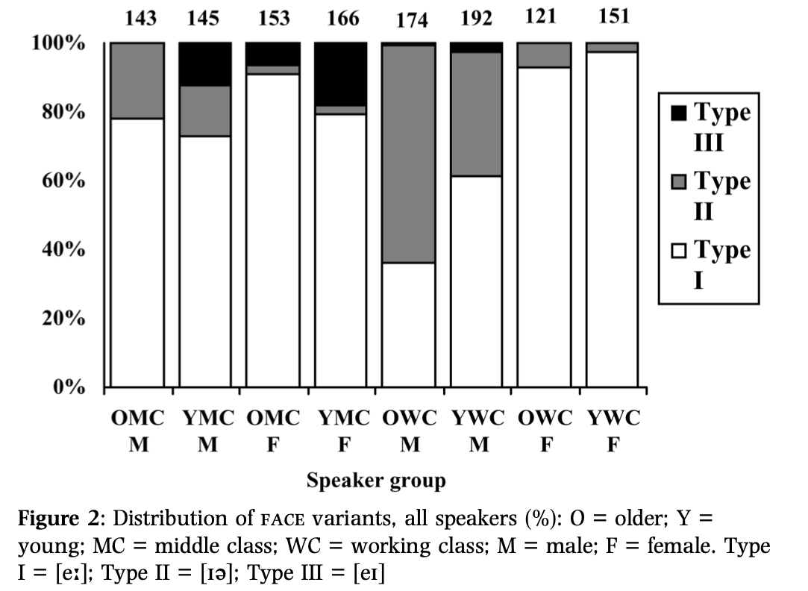
Dialect levelling
Watt (2002): the specifically local variants, centering diphthongs [ɪə] [ʊə], are being lost in favour of the supra-local variants, monophthongal [eː] [oː].

Slide 13
Dialect levelling
Watt (2002): the specifically local variants, centering diphthongs [ɪə] [ʊə], are being lost in favour of the supra-local variants, monophthongal [eː] [oː].
Older speakers show higher rates of the local variant within their own social class category, with the highest rates among working-class men, and very little of the national variant.

Slide 14
Dialect levelling
Watt (2002): the specifically local variants, centering diphthongs [ɪə] [ʊə], are being lost in favour of the supra-local variants, monophthongal [eː] [oː].
Younger speakers show lower rates of the local variant, but more of both the national variant and the supralocal variant; the supralocal variant still predominates over the national variant.

Slide 15
Dialect levelling
Watt (2002): the specifically local variants, centering diphthongs [ɪə] [ʊə], are being lost in favour of the supra-local variants, monophthongal [eː] [oː].
Female speakers don’t use very much of the local variant at all; the national variant might be on the rise in the middle classes.

Slide 16
Dialect levelling
Watt (2002): the specifically local variants, centering diphthongs [ɪə] [ʊə], are being lost in favour of the supra-local variants, monophthongal [eː] [oː].
More of the local variant among male speakers, but it still seems to be on its way out.

Slide 17
Dialect levelling
Viereck (1968): historically, Tyneside English has been quite stable, and these recent changes are therefore signs of a very recent succumbing to the onslaught of standardisation.
Some dialectal features seem to be more stable and less likely to succumb to Standard English in the near future. Others, however, will no doubt soon be completely replaced, especially since [Gateshead] is urban and consequently the pressure of the standard language rather great, so that the traditional dialect is bound to become increasingly mixed. […] [T]he time will soon come when historically developed, genuine dialect phonemes are no longer heard. (Viereck 1968: 76)
One question this raises for us should be: is this kind of thinking really true? Is levelling and the loss of locally-distinctive features some kind of inevitability of language change?
— where do ‘local’ variants come from, anyway? This (arguably rather gloomy) picture of the future of dialectology — which is also a pretty common lay-person’s idea of ‘traditional dialects’ — is really a unidirectional picture, assuming that standardisation, demographics, population migration […] cause the inevitable ‘flattening’ of all regional variation.
But do we really think this is the case?

Slide 18
New dialect formation
A nice type of test-case for our ideas about what is inevitable or non-inevitable in dialect contact: situations of new-dialect formation:
Britain & Trudgill 1999, Trudgill 2004: the emergence of distinctive, new varieties of language, following the migration of people speaking different but mutually-intelligible varieties to a new territory.
Really an extreme and very rapid kind of ‘contact’ and ‘convergence’.
There seem to be a few main scenarios in which this kind of thing happens:
Most centrally, isolated new settlement of a large territory, either uninhabited or from which a previous population is [ … colonisation goes here …]
New Zealand English, to follow.
Arguably closely-related is the formation of new towns, in geographically-bounded areas
Milton Keynes, etc. Possibly also including the rapid expansion of ports etc. during industrialisation; so (early) Liverpool English may be an instance of this process.

Slide 19
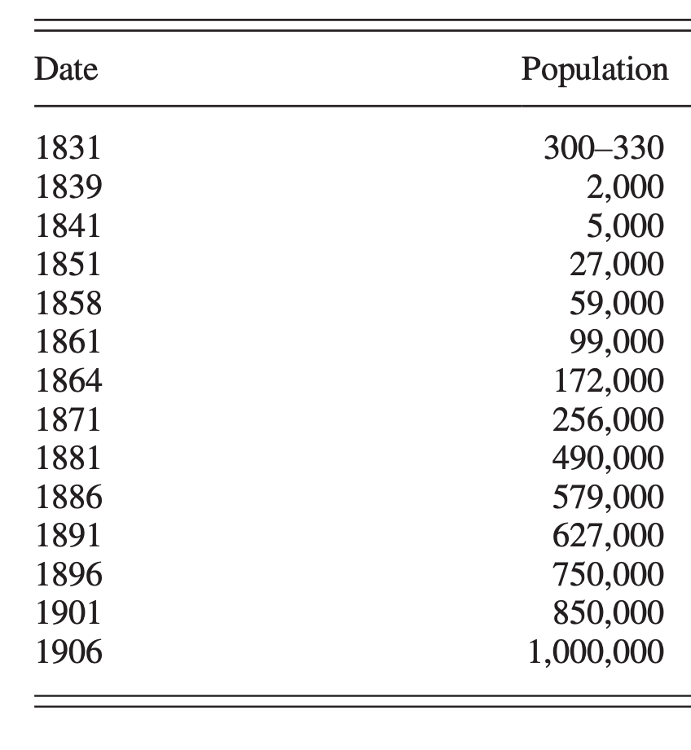
New Zealand English
New Zealand English is one of the most recent varieties of colonial English to emerge.
Although the first European settlers arrived in the 1790s, substantial numbers of Europeans began to arrive in New Zealand only after the Treaty of Waitangi (1840) (Gordon et al. 2004: 38–39; Trudgill 2004: 24).
It seems to be generally agreed that New Zealand was rapidly overwhelmingly populated by speakers of English varieties, and the influence of the indigenous language, Maori (Malayo-Polynesian) was minimal (Gordon et al. 2004; Trudgill 2004).
New Zealand is geographically isolated from other English-speaking communities, although there was significant movement between NZ and Australia; and crucially, populated by speakers of different varieties of English.
European population of NZ in the 19th century, from Baxter, Blythe, Croft & McKane (2009) — more specific sources of these numbers there.

Slide 20
New Zealand English
New Zealand English is one of the most recent varieties of colonial English to emerge.
Although the first European settlers arrived in the 1790s, substantial numbers of Europeans began to arrive in New Zealand only after the Treaty of Waitangi (1840) (Gordon et al. 2004: 38–39; Trudgill 2004: 24).
It seems to be generally agreed that New Zealand was rapidly overwhelmingly populated by speakers of English varieties, and the influence of the indigenous language, Maori (Malayo-Polynesian) was minimal (Gordon et al. 2004; Trudgill 2004).
New Zealand is geographically isolated from other English-speaking communities, although there was significant movement between NZ and Australia; and crucially, populated by speakers of different varieties of English.
European population of NZ in the 19th century, from Baxter, Blythe, Croft & McKane (2009) — more specific sources of these numbers there.
Treaty of Waitangi
By this point half the population is non-Maori — after this English is definitively the majority language.
First big generation of European settlers born in New Zealand around this time.

Slide 21
New Zealand English
The distinctive, stable, NZ dialect of English probably emerged with the generation born around 1890.
Amazingly, we can listen to some of this stuff. Sound recordings made by the Mobile Disc Recording Unit of the New Zealand Broadcasting Service, 1946–1948, recording speakers born through the mid-1800s!
Part of the ONZE corpus, which consists of this, an intermediate archive 1960–2000, and the ‘Canterbury corpus’ (lots of work on this data!), 1994–.

Slide 22
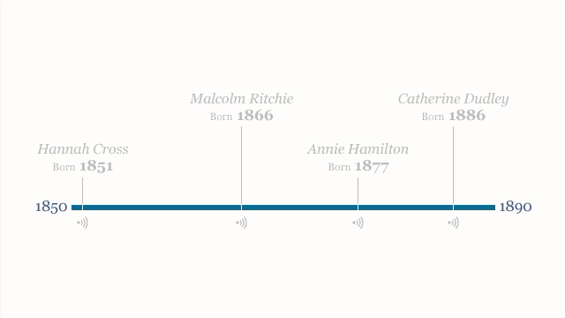
New Zealand English
The distinctive, stable, NZ dialect of English probably emerged with the generation born around 1890.
Amazingly, we can listen to some of this stuff. Sound recordings made by the Mobile Disc Recording Unit of the New Zealand Broadcasting Service, 1946–1948, recording speakers born through the mid-1800s!
Part of the ONZE corpus, which consists of this, an intermediate archive 1960–2000, and the ‘Canterbury corpus’ (lots of work on this data!), 1994–.
Hannah Cross (1851, Dunedin): Scottish English (listen to STRUT, Aitken’s Law, ‘wh’ …)
Malcolm Ritchie (1866, Dunedin): bit of a mixed bag, but perhaps most like SW England of that date.
Annie Hamilton (Arrowtown, 1877): Irish parents, but NZ-born; doesn’t sound Irish at all.
Catherine Dudley (Otago, 1886): listen to the vowel system; if this is like anything, it’s like present-day NZE.
Video available at https://teara.govt.nz/en/video/40124/changing-new-zealand-speech

Slide 23
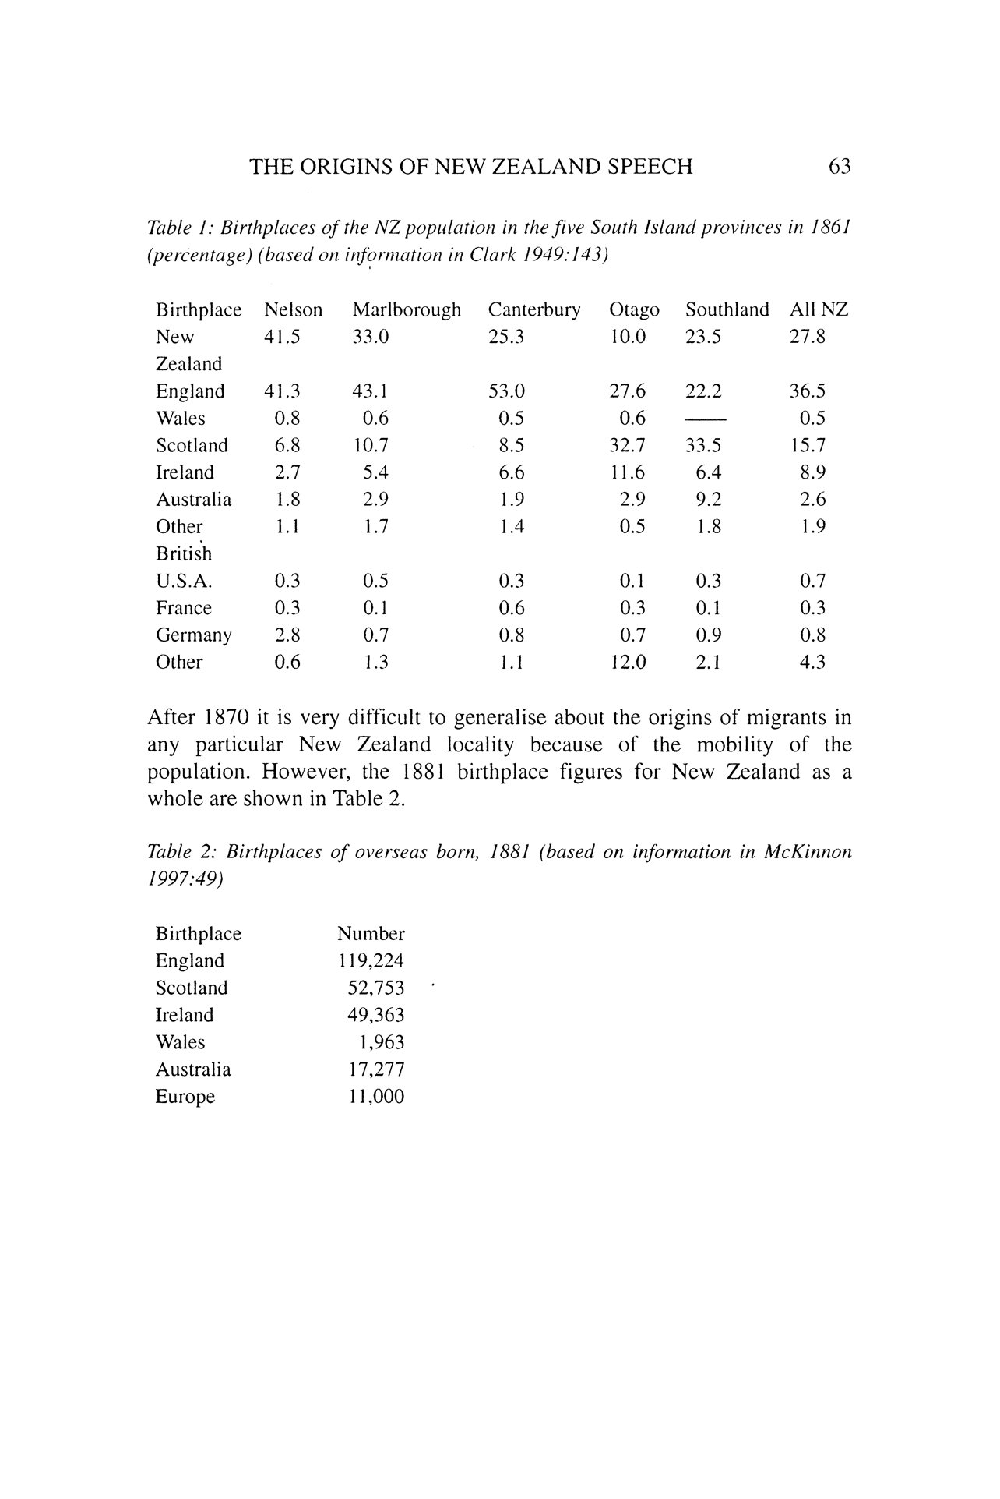
New Zealand English
What contributed to the formation of this variety?
The vast majority of immigrants at this time came from the British Isles (Gordon et al. 2004: 44), although many of these came via Australia.
The British immigrants largely came from southern England (Gordon et al. 2004: 139; Trudgill 2004:16), Scotland, and Ireland.
A bit variable across localities. Census 1861 (Gordon 1998), just for the south island:
So, a variety of British English dialects with a notable gap — generally no varieties of Northern England.

Slide 24
New Zealand English
What contributed to the formation of this variety?
The vast majority of immigrants at this time came from the British Isles (Gordon et al. 2004: 44), although many of these came via Australia.
The British immigrants largely came from southern England (Gordon et al. 2004: 139; Trudgill 2004:16), Scotland, and Ireland.
A bit variable across localities. Census 1861 (Gordon 1998), just for the south island:
So, a variety of British English dialects with a notable gap — generally no varieties of Northern England.
Early prescriptive commentary (Gordon et al. 2004):
Samuel McBurney (a Scottish singing teacher): plenty of phonological documentation, and a fun source on early 19th c. NZE, although a lay-person with a lot of weird judgments.
lots of variability in eg. vowel quality.
‘why there should be a general tendency, as there undoubtedly is in Australia, to a Cockney pronunciation’
In 1912, one commentator discussing the New Zealand accent said, ‘it fortunately has not reached the despairing depths of what we in New Zealand call “Orstreilian”, but it is in grave danger of touching that point’ (quoted in Gordon et al. 2004: 63)

Slide 25
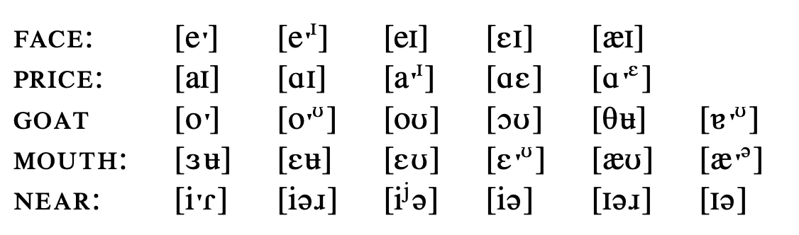
New Zealand English
Are there specific features of New Zealand English that we want to explain?
We’ve seen already that the vowel system of modern NZE is very different from the vowel system of the ‘parent’ varieties, both in the supervision exercises and in previous lectures on the phonological typology of English dialects.
Something that’s very striking about the early New Zealand archive: how different speakers are from one another. Kerswill & Trudgill (2005): ‘among nine Arrowtown people born between 1863 and 1886, we find the following vowel variants’:
On the one hand, most of these variants are used somewhere in the British Isles. On the other, it turns out that none of these NZE speakers really uses a variety that corresponds to a single British variety.
K & T (2005): one single speaker has dental stops for the dental fricatives and clear coda /l/ like Irish English; h-dropping; /ʍ􏰌/ and /w/, thus distinguishing ‘which’ and ‘witch’, [ei] gate but [εi] chain. (Much of this is not the case in modern NZE — watch out!)
Early NZE speakers seem to be making idiosyncratic selections of features from all of the available choices anywhere in the dialect mixture.

Slide 26
New Zealand English
This early wild variability isn’t really still around today. Like any other broadly-defined variety, New Zealand English is variable; but there is now a distinctive variety.
Different theories of what exactly that final version is. Trudgill (1986) considers and discards a few options:
South-Eastern / London English? Lass (1990: 247) makes the rather shocking claim that there is no ETE [Extraterritorial English, i.e. colonial variety of English] that is not a dialect of Southern English’ . Many studies of New Zealand English like this: Bauer (1994: 391), ‘it is clear that New Zealand English derives from a variety of English spoken in the south-east of England’ and, ‘phonologically speaking, New Zealand English is a variant of the south-east England system.
The colonial varieties all continue trends already present in England but slowed down there by the inhibiting influence of RP.
Australian.
Our focus is a different option, explanation via new dialect formation and drift.

Slide 27
New dialect formation (again)
Trudgill distinguishes three stages, seen as corresponding roughly to generations (Trudgill 2001, 2004; Trudgill et al. 1998; also Kerswill and Williams 2000).
Generation 1. Rudimentary levelling: The first stage of new-dialect formation involves initial contact between speakers of different regional and social varieties in a new location, with small amounts of accommodation of adult speakers towards the beginnings of an interdialect. New Zealand: until approx. 1860 (the first speaker we heard).
Generation 2. Extreme variability.
In stable situations, children normally learn to speak like their peers; in a dialect-mixture situation, there is no single peer-dialect for children to acquire, and children have several different linguistic models to aim at. The prediction is then that children will select variants from different dialects and form them into new combinations.
Some loss of linguistically-marked forms and survival of unmarked forms.
Generation 3. Focusing. The new dialect is expected to appear as a stable, crystallised variety, with the most frequent, majority forms eventually winning out.

Slide 28
New dialect formation (again)
Trudgill distinguishes three stages, seen as corresponding roughly to generations (Trudgill 2001, 2004; Trudgill et al. 1998; also Kerswill and Williams 2000).
Generation 1. Rudimentary levelling: The first stage of new-dialect formation involves the initial contact between speakers of different regional and social varieties in a new location, with small amounts of accommodation of adult speakers to one another towards the beginnings of an interdialect. New Zealand: until approx. 1860 (the first speaker we heard).
Generation 2. Extreme variability.
In stable situations, children normally learn to speak like their peers; in a dialect-mixture situation, there is no single peer-dialect for children to acquire, and children have several different linguistic models to aim at. The prediction is then that children will select variants from different dialects and form them into new combinations.
Some loss of linguistically-marked forms and survival of unmarked forms.
Generation 3. Focusing. The new dialect is expected to appear as a stable, crystallised variety, with the most frequent, majority forms eventually winning out.
Features of traditional dialects of the 19th century that aren’t present in any NZE. No sign of ‘East Anglian short o’, FOOT vowel in GOAT words like ‘bone’, although this is still just about around in the Survey of English Dialects today. No centralised Scottish KIT vowel, despite the centralness of this vowel in modern NZE (stay tuned).
Variability with respect to the ‘original’ regional varieties. Recall the speaker mentioned previously in the establishment of early extreme variability. ‘Mr. Ritchie’ (born 1866, with Scottish parents) has dental stops for the dental fricatives and clear coda /l/ like Irish English; h-dropping; /ʍ􏰌/ and /w/, thus distinguishing ‘which’ and ‘witch’, [ei] gate but [εi] chain.
Intra-individual variability in phonetic space. Mr. Edgar, born in Coromandel in 1874, whose parents came from Gloucestershire, has DRESS vowels which totally overlap the KIT vowel and extend well into the space for TRAP. Mrs. Dudley (born in Otago in 1886) has TRAP overlapping with DRESS, but not consistently.
Inter-individual variability. Not very different in age or geographical origin, but often wildly different in production.
Eventually, this all ‘calms down’, and many of the forms that win are SE English, which was also probably the demographically largest variant. Close variants of DRESS and TRAP; BATH vowel as /a:/ although 48% of speakers had this only before fricatives (after, grass, path) but /æ/ before nasals (dance, plant, sample); Diphthong-shifted vowels, e.g. [æʊ] for MOUTH as in London (Cockney) English; no dental stops …

Slide 29
New dialect formation (again)
Determinism. A major argument that Trudgill makes is that all this isn’t random.
‘If the British Isles varieties that went into the initial dialect mixture were roughly the same for all southern hemisphere countries, and in approximately the same proportions, then it is not surprising if the output of the mixture is roughly the same in each case. This is particularly likely to be so if it is true . . . that the same universal or at least widespread levelling tendencies were at work in each of the dialect contact situations.’ (1986: 144)
‘Given sufficient information about the dialects which contribute to a mixture, and sufficient demographic information about the proportions of speakers of the different dialects, it is possible to make predictions about...the outcome‘ (T. et al. 2000: 299)
Similarities between geographically separated varieties of a single language may therefore be due not to continued contact or connection between them, but to the fact that they developed from similar mixtures of similar dialects in similar proportions at similar times. Trudgill argues that this is the actual reason NZE is like AusE.

Slide 30
New Zealand English (again)
The story so far: several different varieties constituted the input to early New Zealand English. These varieties mixed in a fairly uncontrolled way in early stages of the formation of NZE as a distinct variety; eventually, however, particular features of these varieties ‘won out’, with a general tendency towards the features of the South-East of England.
Is that it? There are a few things that we need to explain here.
While ‘settlement from England’ was the plurality, the Scots and Irish component was substantial; how do we explain where features that are common between Scottish and Irish varieties do and don’t win?
Modern New Zealand DRESS, TRAP are very close; modern Scottish and Irish DRESS and TRAP are fairly open and not that different from one another.
But all the speakers in Trudgill’s data (for NZE speakers born at the turn of the 19th century) were at least partially rhotic, i. e. produced post-vocalic rhotics.
There are some developments in post-19th-century New Zealand English that don’t look solely like the selection of one variant from the ‘library’ of existing variants.
Diphthong shift: remember the description of the London Diphthong Shift that you saw in Lecture 3, with FLEECE, FACE, PRICE, CHOICE / GOOSE, GOAT, MOUTH undergoing further chain-shifting in phonetic space.
Fronting and lowering of STRUT (this is new!)
Loss of rhoticity. Trudgill’s 19th-c speakers are rhotic; modern speakers are not.
HAPPY-tensing was the norm in NZ before it was the norm in England!

Slide 31
Drift
Sapir (1921:150): “language moves down time in a current of its own making. It has a drift.”
A very old idea about language change, and in particular what we predict about language change in related languages / language families:
The momentum of ... drift is often such that languages long disconnected will pass through the same or strikingly similar phases.... The English type of plural represented by foot: feet, mouse: mice is strictly parallel to the German Fuss: Füsse, Maus: Mäuse... there could have been no plurals of this type in Primitive Germanic... There was evidently some general tendency or group of tendencies in early Germanic, long before English and German had developed as such, that eventually drove both of these dialects along closely parallel paths. (1921: 172)
So, the basic idea is that languages that derive from the same historical source continue to undergo changes that take them in the same direction.
Is this true? We don’t now believe a lot of the ideas about typology, language structure, teleology, etc. that were ordinary in Sapir’s day (you’ve seen the debate about traditional morphological types in Li 3) …
… but there are some reasons to think that this can sometimes be a good explanation.

Slide 32
Drift
Trudgill et. al. (2000): there are two situations in which Sapirian drift could occur in cases like New Zealand English.
A change is already in progress in the source variety(/ies); since it’s present at a low level in the input, it continues in the same direction after separation.
Varieties with a common source inherit shared tendencies — not actual changes in progress, but eg. across-the-board phonetic details that predispose further change.
Diphthong shift. Throughout the ONZE / Mobile Unit data, these kinds of realisation are consistently on the rise; the change in progress probably was inherited directly from the contemporaneous English of SE England.
Fronting and lowering of STRUT. STRUT in NZE is fronter and lower than in RP, although we didn’t get into this in Lecture 3; Wells vs. Bauer et al. 2007 for more. But in modern RP, it's also really probably fronter than the cardinal /ʌ/; inherited change again. (Also a feature of other ‘colonial English’.)
Already around in the descriptions of McBurney — NZ ahead of Australia, London?
iː
uː
FLEECE
GOOSE
eɪ
oɪ
əʊ
FACE
CHOICE
GOAT
aɪ
ɔɪ
æʊ
aʊ
PRICE
MOUTH
Diphthong Shift schematic (after Wells 1982: 256)
STRUT
STRUT

Slide 33
Drift
Trudgill et. al. (2000): there are two situations in which Sapirian drift could occur in cases like New Zealand English.
A change is already in progress in the source variety(/ies); since it’s present at a low level in the input, it continues in the same direction after separation.
Varieties with a common source inherit shared tendencies — not actual changes in progress, but eg. across-the-board phonetic details that predispose further change.
Diphthong shift. Throughout the ONZE / Mobile Unit data, these kinds of realisation are consistently on the rise; the change in progress probably was inherited directly from the contemporaneous English of SE England.
Fronting and lowering of STRUT. STRUT in NZE is fronter and lower than in RP, although we didn’t get into this in Lecture 3; Wells vs. Bauer et al. 2007 for more. But in modern RP, it's also really probably fronter than the cardinal /ʌ/; inherited change again. (Also a feature of other ‘colonial English’.)
Already around in the descriptions of McBurney — NZ ahead of Australia, London?
Rhoticity loss. Bailey (1996: 100) says of English English that “the shift from consonantal to vocalic r, though sporadic earlier, gathered force at the end of the eighteenth century”. Strang (1970:112) writes that “in post-vocalic position, finally or pre-consonantally, /r/ was weakened in articulation in the seventeenth century and reduced to a vocalic segment early in the eighteenth century”.
There’s some uncertainty about dating the development of non-rhoticity in England (and as you know, there has been plenty of progression of this change over the last hundred years; these categorical statements are too categorical).
Two possible explanations, of which Trudgill et al. prefer the second:

Slide 34
Drift
Trudgill et. al. (2000): there are two situations in which Sapirian drift could occur in cases like New Zealand English.
A change is already in progress in the source variety(/ies); since it’s present at a low level in the input, it continues in the same direction after separation.
Varieties with a common source inherit shared tendencies — not actual changes in progress, but eg. across-the-board phonetic details that predispose further change.
Diphthong shift. Throughout the ONZE / Mobile Unit data, these kinds of realisation are consistently on the rise; the change in progress probably was inherited directly from the contemporaneous English of SE England.
Fronting and lowering of STRUT. STRUT in NZE is fronter and lower than in RP, although we didn’t get into this in Lecture 3; Wells vs. Bauer et al. 2007 for more. But in modern RP, it's also really probably fronter than the cardinal /ʌ/; inherited change again. (Also a feature of other ‘colonial English’.)
Already around in the descriptions of McBurney — NZ ahead of Australia, London?
The influence of the prestige British model.
Continued implementation of some inherited piece of phonetic detail — ‘weak’ articulations of the rhotic and the existence of low levels of post-vocalic rhotic loss throughout the population led to rhoticity loss ‘taking off’ as a sound change, as it did in English.
Rhoticity loss. Bailey (1996: 100) says of English English that “the shift from consonantal to vocalic r, though sporadic earlier, gathered force at the end of the eighteenth century”. Strang (1970:112) writes that “in post-vocalic position, finally or pre-consonantally, /r/ was weakened in articulation in the seventeenth century and reduced to a vocalic segment early in the eighteenth century”.
There’s some uncertainty about dating the development of non-rhoticity in England (and as you know, there has been plenty of progression of this change over the last hundred years; these categorical statements are too categorical).
Two possible explanations, of which Trudgill et al. prefer the second:

Slide 35
Drift
Trudgill et. al. (2000): there are two situations in which Sapirian drift could occur in cases like New Zealand English.
A change is already in progress in the source variety(/ies); since it’s present at a low level in the input, it continues in the same direction after separation.
Varieties with a common source inherit shared tendencies — not actual changes in progress, but eg. across-the-board phonetic details that predispose further change.
Happy-tensing, /i/ in the final syllable of ‘happy’, ‘money’. In England, this is most characteristic of southern accents; completely absent from the ONZE informants born in the 1850s, but begins to show up in those born in the 1860s, increasing gradually thereafter.
Trudgill et al: This makes it less likely that HAPPY-tensing arrived in New Zealand from Britain, and more likely that it started life independently in New Zealand; what NZE inherited was some kind of pre-phonological phonetic property, and the structural condition that in most varieties of English, the distinction between /ɪ/ and /i/ is neutralised in unstressed word-final position anyway.

Slide 36
Summary
Summarising what Trudgill and colleagues think about New Zealand English:
New dialect formation: in situations in which dialects ‘mix’, the final winners tend to be whatever the majority was in the input, after an intermediate period of variability. This is then related to dialect levelling; what is it that causes Tyneside speakers (Watt 2000) to converge towards particular forms over time?
Drift: similar changes occur in the ‘New Englishes’ because they’ve inherited the predisposing conditions that set up particular changes.
Other cases to think about: work also by Trudgill on the formation of new varieties in the new towns (e. g. Milton Keynes); Honeybone (2007) on Liverpool English, which he argues underwent a similar process with input from the surrounding Lancashire varieties, Irish, Scottish, and Welsh English.
The general problems of the geographical diffusion of languae change.
Something to keep in mind for next week: do we think that the effects seen here are unlike other ‘contact’ effects because the varieties that are in contact are close enough to be considered ‘the same language’?

Slide 37
Suggested reading
Not a full list of references, get in touch if you’re looking for anything else mentioned.
Gordon, Elizabeth, et al. 2004. New Zealand English: Its origins and evolution. Cambridge: Cambridge University Press.
Trudgill, Peter, Elizabeth Gordon, Gillian Lewis & Margaret Maclagan. 2000a. Determinism in new-dialect formation and the genesis of New Zealand English. Journal of Linguistics 36, 299–318.
Trudgill, Peter, Elizabeth Gordon, Gillian Lewis & Margaret MacLagan. 2000b. The role of drift in the formation of native-speaker southern hemisphere Englishes: Some New Zealand evidence. Diachronica 17, 111–38.
Watt, Dominic. 2002. ‘I don’t speak with a Geordie accent. I speak, like, the Northern accent’: Contact-induced levelling in the Tyneside vowel system. Journal of Sociolinguistics 6/2: 44-63.
Honeybone, Patrick. 2007. ‘New dialect formation in nineteenth century Liverpool: A brief history of Scouse’. In: Grant, A., Grey, C. & Watson, K. (eds) The Mersey Sound: Liverpool’s Language, People and Places. Liverpool: Open House Press. Available online: http://www.lel.ed.ac.uk/homes/patrick/livengkoi.pdf
Bonus content. Modern New Zealand English in the wild: Fr[ɪ]d the football-playing sheep from Otago.

